Slide 1


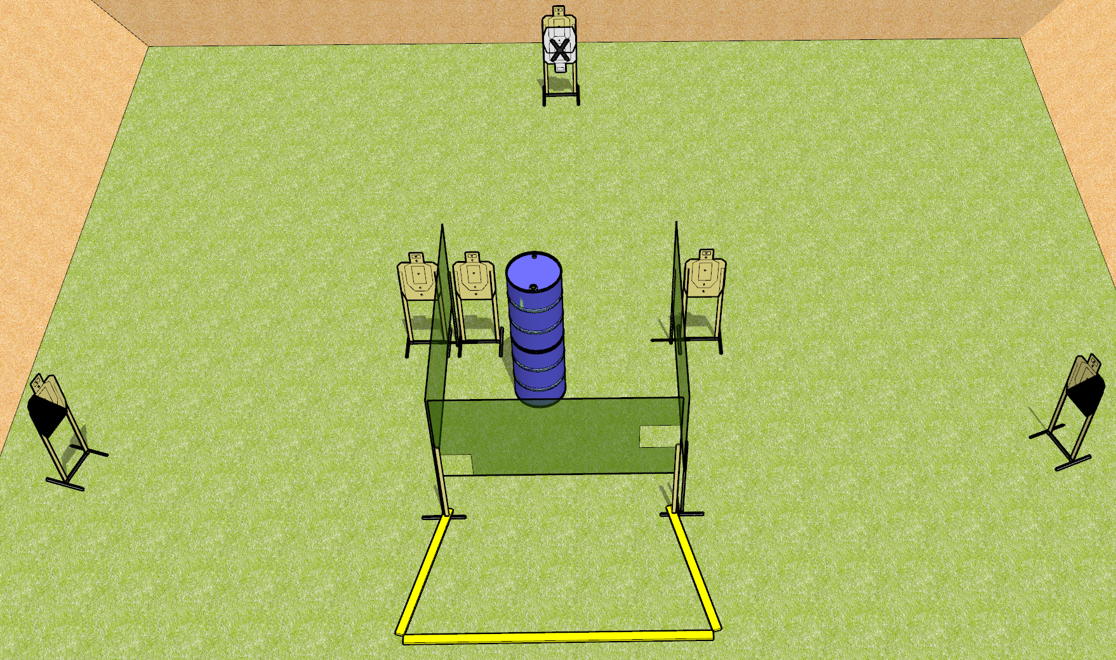
 | Dothan Gun Club – USPSA Match Simply Short Course Designer : Drew Coleman
Round Count 12 rounds 6 USPSA targets
Equipment List 4 wall feet 2 medium fault lines 1 left + 1 right diag, 5 targets (4 + 1NS)

Slide 2
Simply Short
Written Stage Briefing
Scoring: Virginia Count
Targets: 6 USPSA
Rounds: 12
Handgun start position: behind the rear fault line, completely outside the shooting area, wrists below belt. Handgun is loaded and holstered.
PCC start position: behind the rear fault line, completely outside the shooting area, stock on belt. Carbine is loaded.
Procedure: On the audible start signal, engage targets as they become available from within the shooting area.

Slide 3
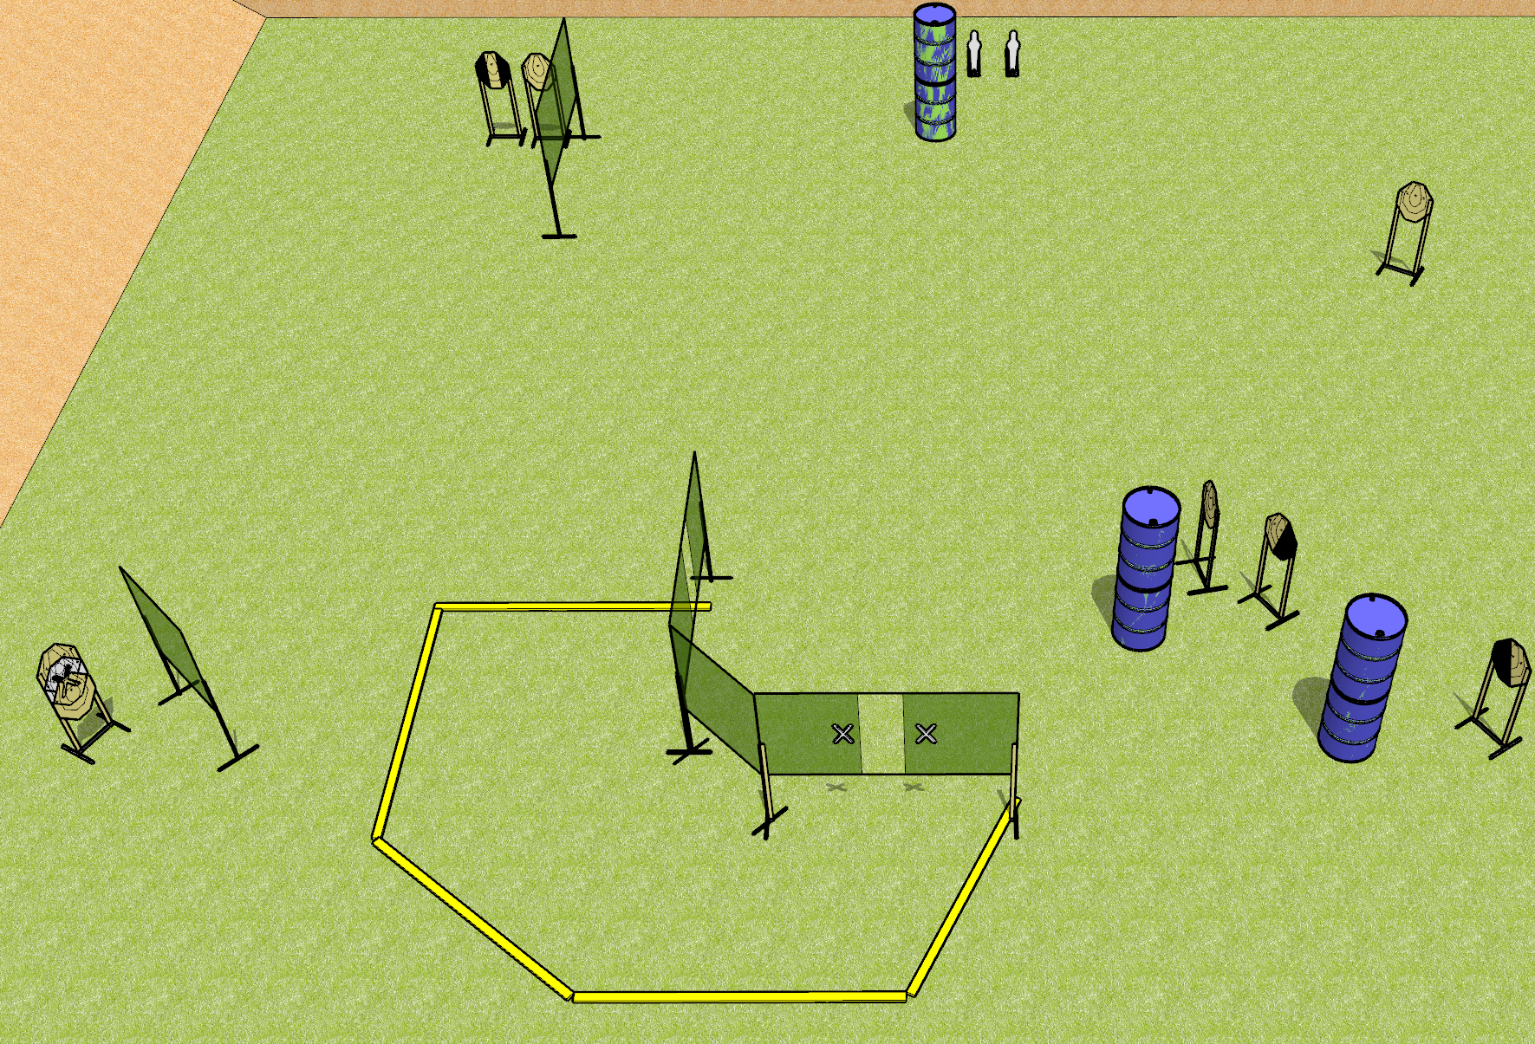
 | Dothan Gun Club – USPSA Match Justified Course Designer : Drew Coleman
Round Count 18 rounds 8 IPSC 2 mini poppers
Equipment List 10 wall feet 1 left + 1 right diag, 1 tux, 6 targets (5 + 1 NS)

Slide 4
Justified
Written Stage Briefing
Scoring: Comstock
Targets: 8 IPSC, 2 poppers
Rounds: 18
Handgun start position: hands touching upper marks. Handgun is UNLOADED and holstered.
PCC start position: muzzle touching lower mark, stock on belt. Carbine is UNLOADED.
Stage Procedure: on the audible start signal, engage targets as they become available from within the shooting area.

Slide 5
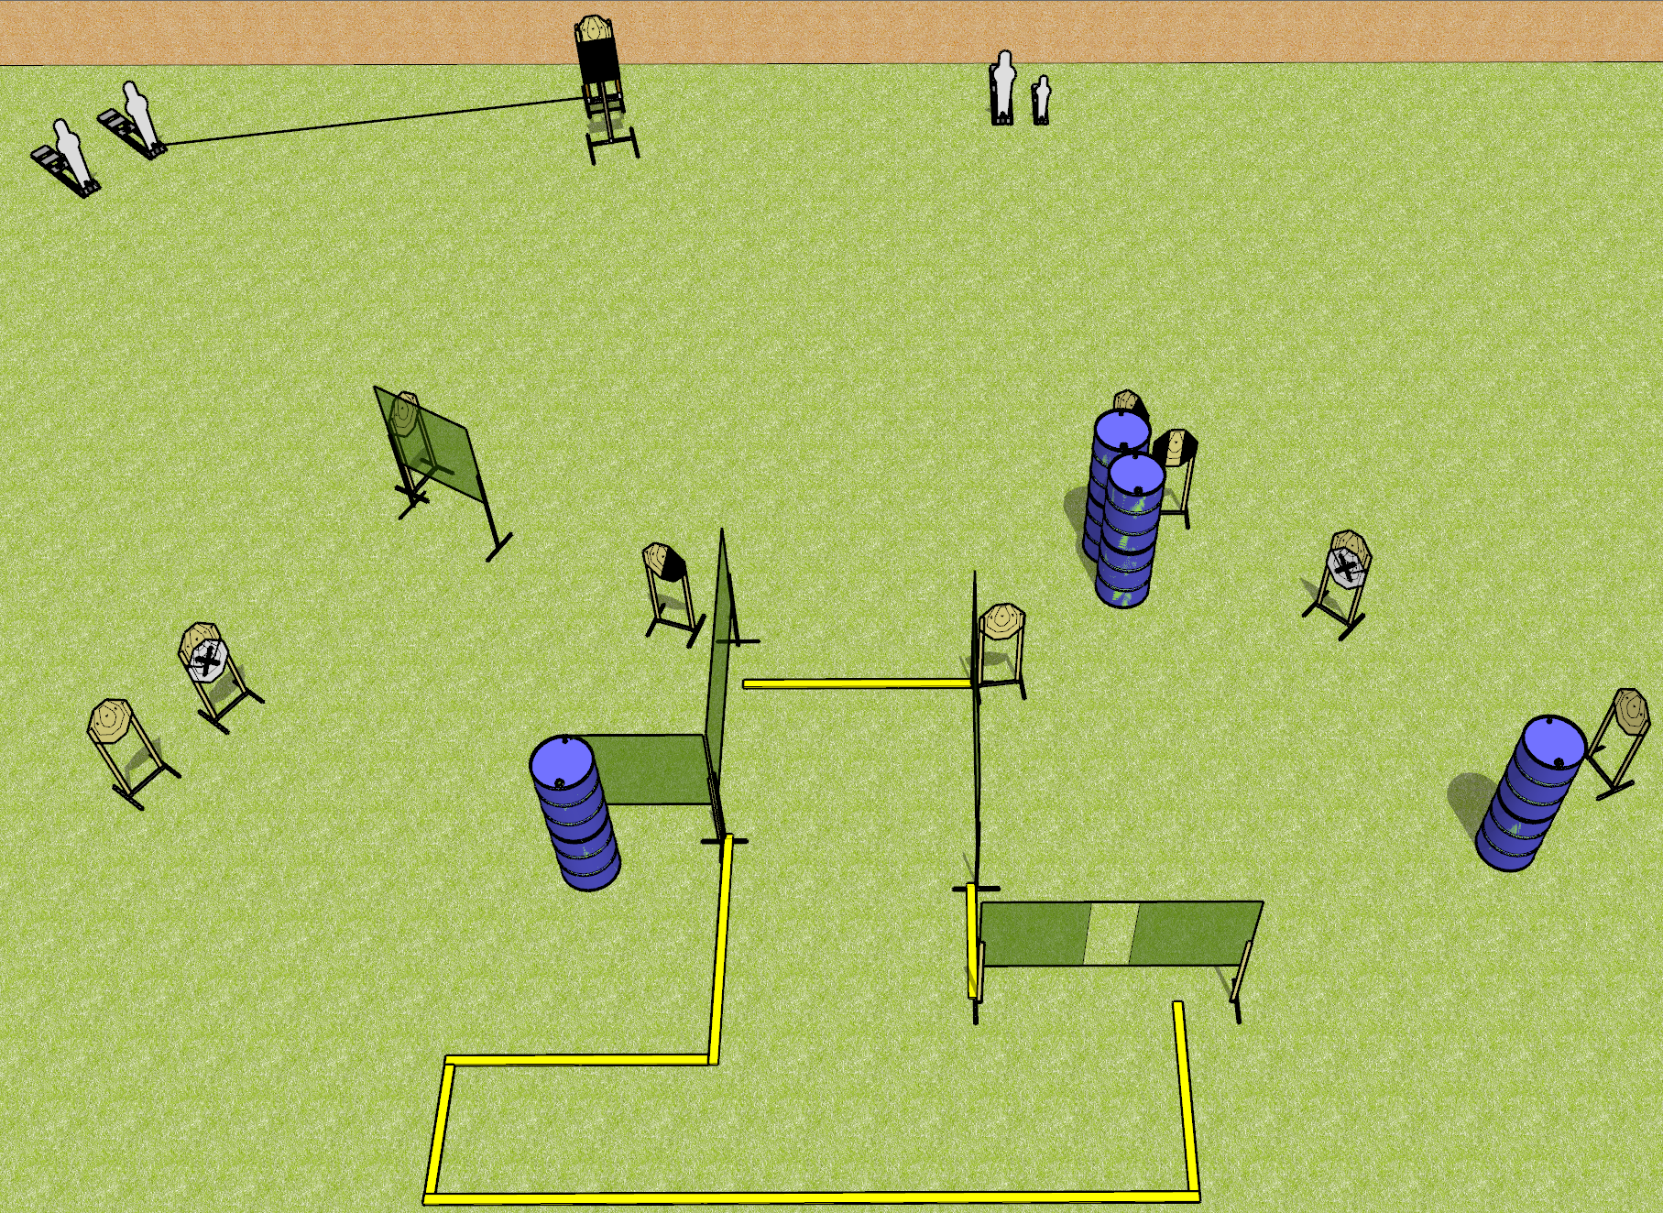
 | Dothan Gun Club – USPSA Match Something Classic Course Designer : Drew Coleman
Round Count 24 rounds 2 colt poppers, 2 mini poppers 10 IPSC
Equipment List 2 4’ walls either side of pull port (instead of port wall) 11 wall feet Use swinger instead of bobber Build it like classic nationals 9 targets (7 + 2 NS) 1 left + 1 right diag, 1 tux (mix and match while posting targets) Use 2 colts and a mini instead of pepper poppers READ THE NOTES DURING SETUP!!!

Slide 6
Something Classic
Written Stage Briefing
Scoring: Comstock
Targets: 10 IPSC, 4 poppers
Rounds: 24
Handgun start position: feet on marks, wrists below belt, handgun loaded and holstered.
PCC start position: feet on marks, stock on belt, loaded.
Procedure: on the audible start signal, engage targets as they become available from within the shooting area. Swinger is activated by P2 and remains visible at rest.

Slide 7
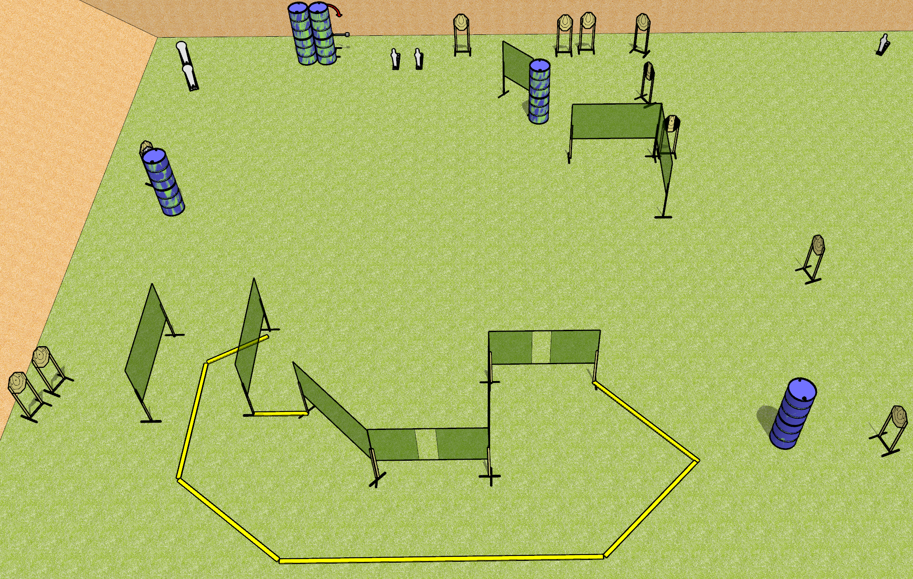
 | Dothan Gun Club – USPSA Match Not Stage #5 Course Designer : Drew Coleman
Round Count 29 rounds 12 IPSC 2 colt, 3 mini
Equipment List 15 wall feet Swinger + activator 2 tux + 10 targets (9 + 1 NS) Use 10’ fault lines for right side area

Slide 8
Not Stage #5
Written Stage Briefing
Scoring: Comstock
Targets: 12 IPSC, 5 poppers
Rounds: 29
Handgun start position: anywhere inside the shooting area, wrists below belt. Handgun is loaded and holstered.
PCC start position: anywhere inside the shooting area, stock on belt. Carbine is loaded.
Stage Procedure: on the audible start signal, engage targets as they become available from within the shooting area. The swinger is activated by P3 and remains visible at rest.

Slide 9
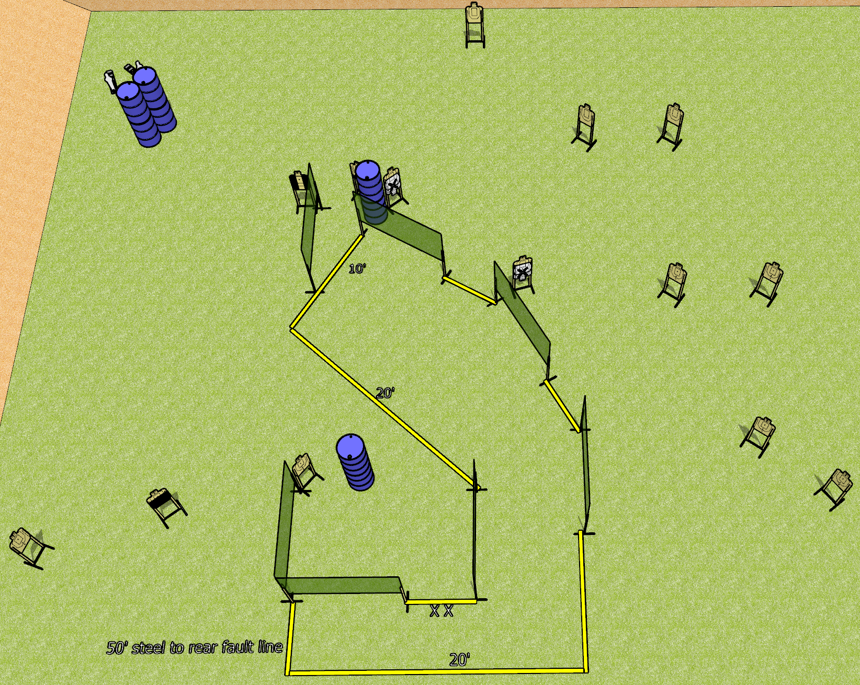
 | Dothan Gun Club – USPSA Match Going Over There Course Designer : Drew Coleman
Round Count 30 rounds 14 USPSA 2 mini poppers
Equipment List 13 wall feet 1 50%, 1 tux, 1 right diag, 13 targets (11 + 2 NS)

Slide 10
Going Over There
Written Stage Briefing
Scoring: Comstock
Targets: 14 USPSA, 2 poppers
Rounds: 30
Handgun start position: toes on X’s, wrists below belt. Handgun is loaded and holstered.
PCC start position: toes on X’s, stock on belt. Carbine is loaded.
Stage Procedure: on the audible start signal, engage targets as they become available from within the shooting area.

